Slide 1
Power Bi
i.Building weekend and year flags
ii. Introduction to conditional aggregations
iii. Working on the CALCUATE function
iv. Calculate weekend and weekday sales
v. Calculate Current Year and Previous Year Sales
vi. Determining YoU Growth with the CY and PY Sales

Slide 2
Introduction to conditional aggregations
Simple agg:
No of custs: count(custid)
Total sales = sum(sales)
Cond agg:
No of Males: count(custid) from customer where gender = 'male'
No of Females: count(custid) from customer where gender = 'female'
CALCULATE(agg_function,filters,....)

Slide 3
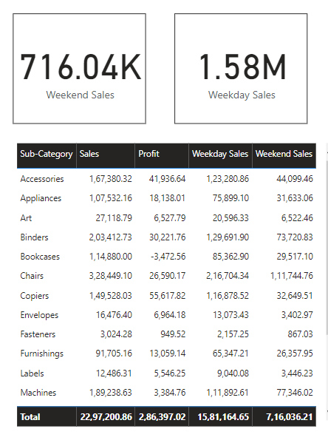
Calculate weekend and weekday sales
Weekend Sales = CALCULATE(SUM(Orders[Sales]),Orders[Weekend Flag] = "Weekend")
Weekday Sales = CALCULATE(SUM(Orders[Sales]),Orders[Weekend Flag] = "Weekday")

Slide 4
Building Year Tag:
Year Tag = if(year(Orders[Order Date]) = year(TODAY()),"Current Year",if(year(Orders[Order Date]) = YEAR(TODAY()) - 1, "Previous Year","Other Years"))
Since data is not available for 2022, the formula is tweaked to make 2021 as the current. The tweaked formula is as mentioned below.
Year Tag = if(year(Orders[Order Date]) = year(TODAY())-1,"Current Year",if(year(Orders[Order Date]) = YEAR(TODAY()) - 2, "Previous Year","Other Years"))year flags

Slide 5
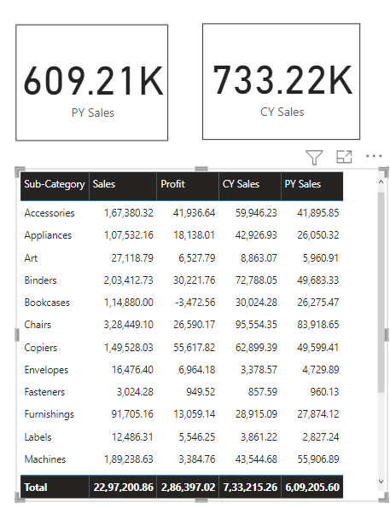
Calculate Current Year and Previous Year Sales
CY Sales = CALCULATE(SUM(Orders[Sales]),Orders[Year Tag] = "Current Year")
PY Sales = CALCULATE(SUM(Orders[Sales]),Orders[Year Tag] = "Previous Year")

Slide 6
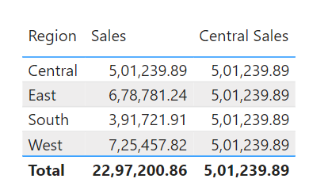
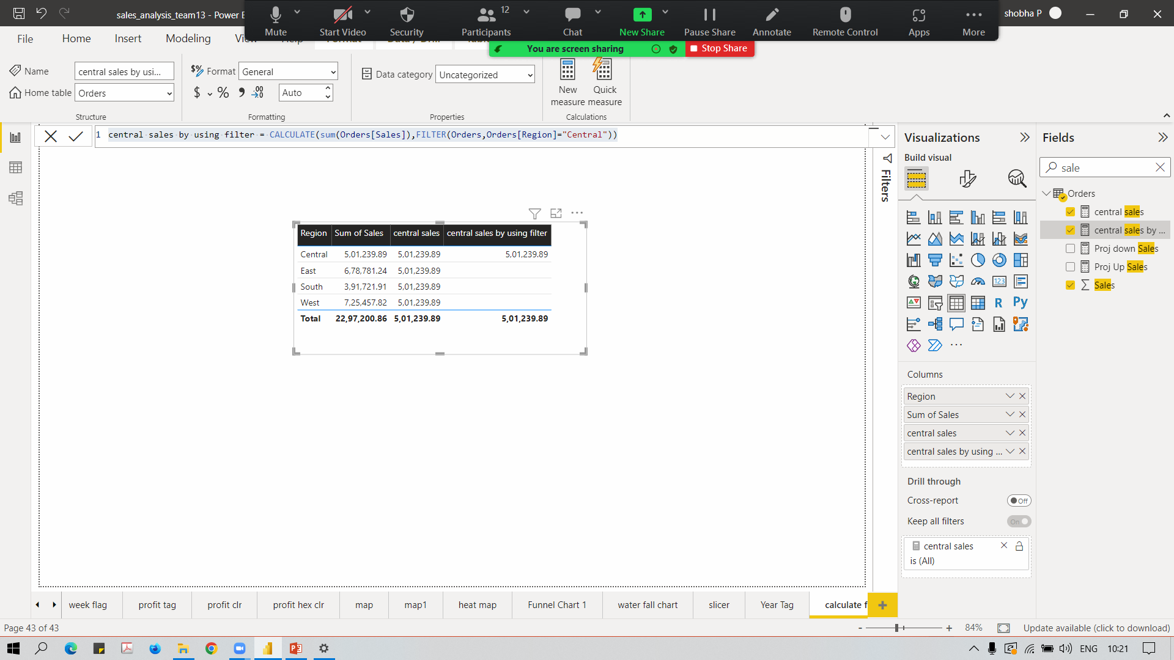
Working on the CALCUATE function
Central Sales = CALCULATE(SUM(Orders[Sales]),Orders[Region]="Central")
central sales by using filter = CALCULATE(sum(Orders[Sales]),FILTER(Orders,Orders[Region]="Central"))

Slide 7
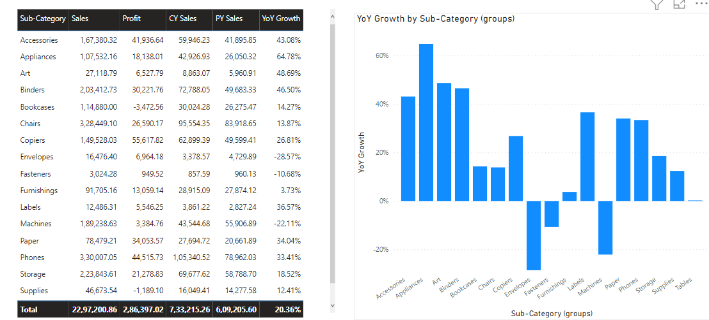
Determining YoY Growth with the CY and PY Sales
YoY Growth = ([CY Sales]-[PY Sales])/[PY Sales]

